Slide 1
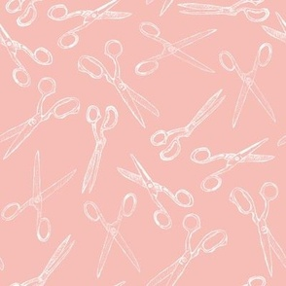

Glamorous Hair Website Booking
Usability test by Diolanda Caballero

Slide 2
Objectives:
Book a haircut and deep conditioning treatment.
Focus on consumer accessibility
Focus on improvements that could be made for better customer experience.

Slide 3

Task 1: Log in and look at the landing page.
Participant wished there were photos of the work.
Participant said booking did not feel like a glamorous experience.
Would like something to match.
Task difficulty: 1/10. It was not difficult to log into the main page.

Slide 4
Task 2: Find and book a haircut and a deep conditioning treatment
Task was straight forward.
- No issue was found when completing this task.
Compared to a barber shop that uses the Square Space booking website.

Slide 5
Book the Appointment and checkout:
Task was completed with little issue.

Slide 6
Results
Website should be brighter and show more images of Wedad's work.
Website is easy to use, however it lacks character and turns people away.
Booking process is very easy and straight forward.
Overall layout is redundant and unnecessary.
Colors make the entire site dull and hard to read.

Slide 7

Recommendation
Change colors to make the website more accessible.
Change home screen button due to redundancy.
Add images because ”Although you could be highly recommended to go to this site, the site does not match the service.”
Images will give the booking site more warmth.
Possible site change to Square Space/Square Go
Add more review information directly on the site.
No changes to the way you book an appointment.

